Slide 1

Cascading Style Sheets

Slide 2
What is CSS?
Stands for Cascading Style Sheets
Responsible for styling the look of your website
You can use CSS to add color and stuff!

Slide 3
How were the pages before css ?
Pages before css were simple page (no style pages)
Example for simple pages (without css)
http://info.cern.ch/hypertext/WWW/TheProject.html

Slide 4
How to write css?
There are there way of inserting style sheet
In-line css
Internal css
External css

Slide 5
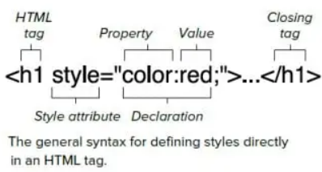
In-line css
An inline style may be used to apply a unique style for a single element.
To use inline styles, add the style attribute to the relevant element. The style attribute can contain any CSS property.

Slide 6
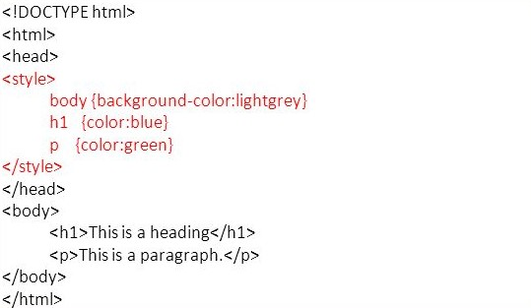
Internal css
An internal style sheet may be used if one single HTML page has a unique style.
The internal style is defined inside the <style> element, inside the head section.

Slide 7
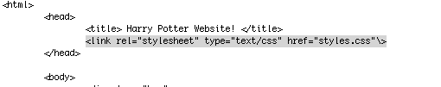
External CSS
Go to your main .html file and add this line
inside the <head> … </head> tags, after the
<title>…</title>:
<link rel="stylesheet" type="text/css" href="styles.css"\> Your page should something look like this:

Slide 8
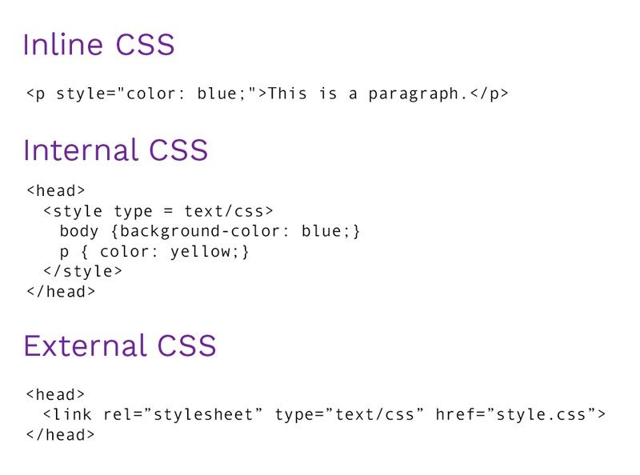
Overview in add style sheet

Slide 9
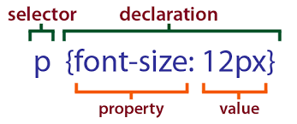
Basic Syntax
FORMAT:
selector {
property: value;
}
selector: what you want styled (e.g. body)
property: what you want changed (e.g. background)
value: the new value of that property (e.g. green)
So you have the thing you want to style followed by a list of properties and the value for that property
This list must be between 2 curly braces

Slide 10
Selectors
CSS selectors are used to "find" (or select) the HTML elements you want to style.
Element selector
Universal selector
Class selector
ID selector

Slide 11
Element Selectors
CSS styles elements of HTML.
For example, to turn all paragraphs’
text green, do:
p {
color : green;
}
Note: selectors are generally an HTML element without “<“ and “>”. So “<p>” becomes “p”, and “<body>” becomes “body”, and “<h1>” becomes “h1”

Slide 12
Example
body {
background: green;
}

Slide 13
Question
How would I turn the background of all paragraphs red?

Slide 14
Answer
p {
background: red;
}

Slide 15
Universal Selectors
The universal selector (*) selects all HTML elements on the page.
The CSS rule below will affect every HTML element on the page
* {
color : green;
}

Slide 16

Selecting in CSS
An important part in styling is learning how to select elements
For example
p{
color : green;
}
In this case, “p” is called a selector,
it selects the thing you want to style
We learned how to select all paragraphs, but suppose you want to select only some?
You’ll need to learn how to use classes and id

Slide 17
Class Selectors
The class selector selects HTML elements with a specific class attribute.
To select elements with a specific class, write a period (.) character, followed by the class name.
.center{
color : red;
}

Slide 18
Classes (continued)
Different types can have the same class name. If you name an h1 element class hugsKitty, and you want both p and h1 to have the same elements then do this:
.hugsKitty{ color : maroon;
}
(Just don’t specify element type but keep the dot in front of the class name)

Slide 19
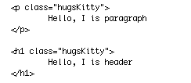

EXAMPLE
INPUT
OUTPUT

Slide 20
Practice!
Create 2 classes named blueFont and purpleFont
blueFont should make the text blue and redFont should make the text red
Apply these classes to sections of your html code
Answer
.blueFont{
color : blue;
}
.redFont{
color : red;
}

Slide 21
ID Selectors
The id selector uses the id attribute of an HTML element to select a specific element.
The id of an element is unique within a page, so the id selector is used to select one unique element!
To select an element with a specific id, write a hash (#) character, followed by the id of the element.
#para1 {
color : green;
}

Slide 22

IDs (continued)
Syntax:
#id_name{
property:value;
}
Example:

Slide 23
Practice
Transform blueFont and redFont classes into IDs
Apply them to your HTML
Answer
#blueFont{ color : blue;
}
#redFont{
color : red;
}

Slide 24
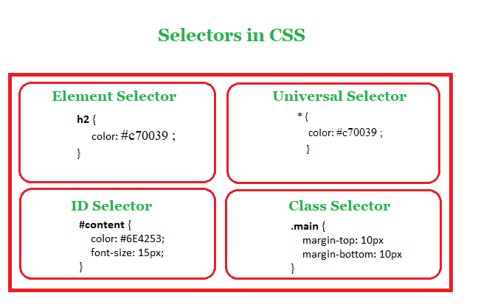
Overview in Selectors

Slide 25
More CSS Syntax
You can put in instructions for multiple elements by simply adding another block of code for the second element under the first
h1{
color: green;
background-color: yellow;
}
h2{
color: green;
background-color: yellow;
}
You can style more than 2 elements and add more than 2 attributes - you can have as many or as few as you want!

